Slide 1

Testing deep learning methods to estimate metallicity for RRL stars.
By : Melika Keshavarzmirzamohammadi
Supervisor : Giuliano Iorio

Slide 2
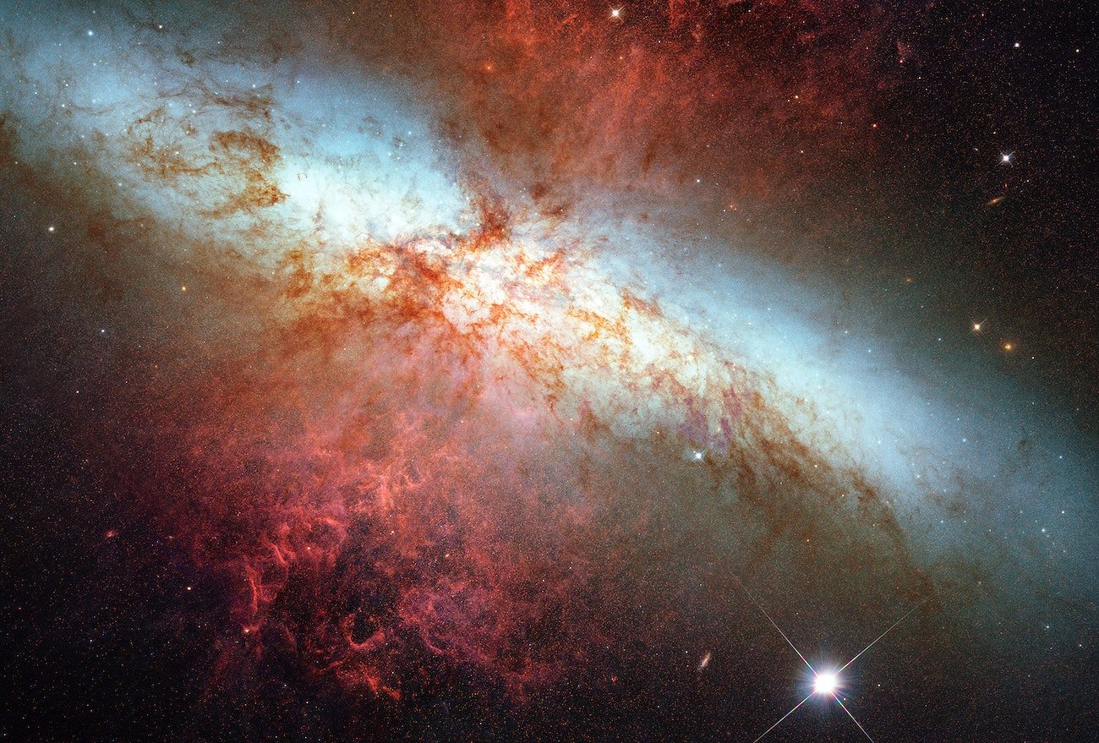
Table of content:
An Introduction to RRL Stars.
Why are we interested in their metallicity?
Processing the light curves.
The Deep learning method
Transfer learning
Result for prediction

Slide 3

1. An Introduction to RRL stars

Slide 4
Variable stars:
The vast majority of stars appear to be constant in location (relative to other stars) and brightness. It turns out neither of these is true; stars change in position and brightness, but more slowly than can be easily noticed during one human lifetime.
A few special stars, however, vary their brightness with a rather short, regular period. These "variable stars" are now known (with modern observational methods) to number well over 30,000 in our region of the Milky Way alone.
Why are they so important to study :
the distance
Age
chemical composition of stars
Because of their old age, RR Lyraes are commonly used to trace certain populations in the Milky Way, including the halo and the thick disk.

Slide 5
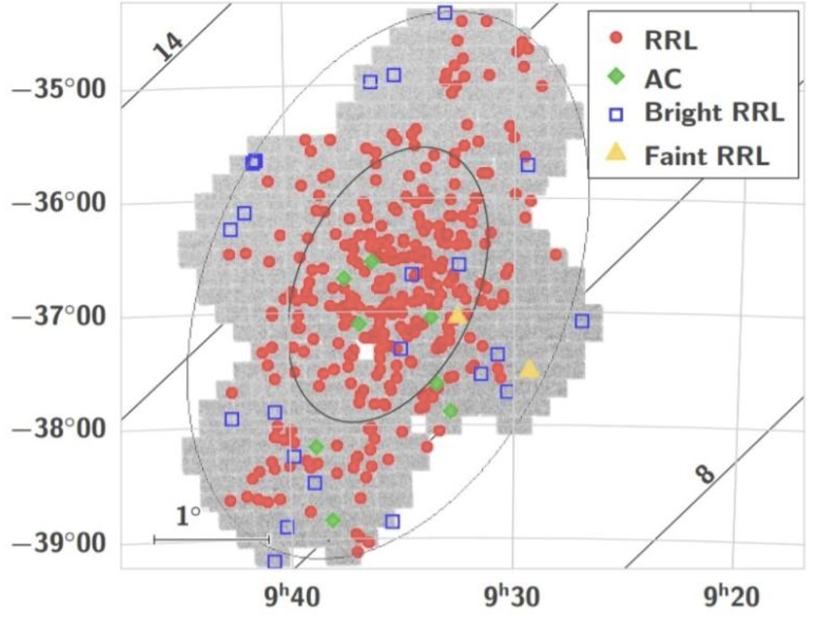
RRL Stars:
RR Lyrae stars (RRLs) are old (>10 Gyr), low-mass (<1 M☉), metal-poor, periodic pulsating variable stars, which are mostly distributed in the bulge, thick disks, globular clusters (GCs), stellar halos, and substructures.
Ant 2 observation of RRL in the Milky Way galaxy conducted by Vivas et al., 2021.

Slide 6
RRL Stars’ cause of pulsation:
K mechanism :
Here, the Greek letter kappa (κ) is used to indicate the radiative opacity at any particular depth of
the stellar atmosphere.
A low opacity means high transparency; a high opacity means low transparency.
In a normal star:
An increase in compression
increase in temperature and density
a decrease in the opacity of the atmosphere
In RRL stars:
Ionized He atmosphere
An increase in opacity (decrease in transparency)
An increase in temperature and density
An increase in compression

Slide 7
RRL Stars Metallicity:
RRL’s stars metallicity is extremely important to study, because:
Age Indicator:
RR Lyrae stars are known to be very old, typically more than 10 billion years old. Their metallicity provides valuable information about the age of the stellar population in which they are found. Older populations tend to have lower metallicities, so studying the metallicity of RRL stars helps constrain the age of the stellar population and the galaxy in which they reside.
2. Distance Measurements:
RR Lyrae stars are used as standard candles, objects of known intrinsic luminosity, to measure distances in the universe. The relationship between the period of variability (P) and the absolute magnitude (M) of RR Lyrae stars, known as the Period-Luminosity (PL) relation, depends on metallicity. Accurate knowledge of metallicity is essential for using RR Lyrae stars as distance indicators.
3. Galactic substructure study: By studying the metallicity distribution of these stars, astronomers can gain insights into the formation and evolution of the galactic substructures..

Slide 8
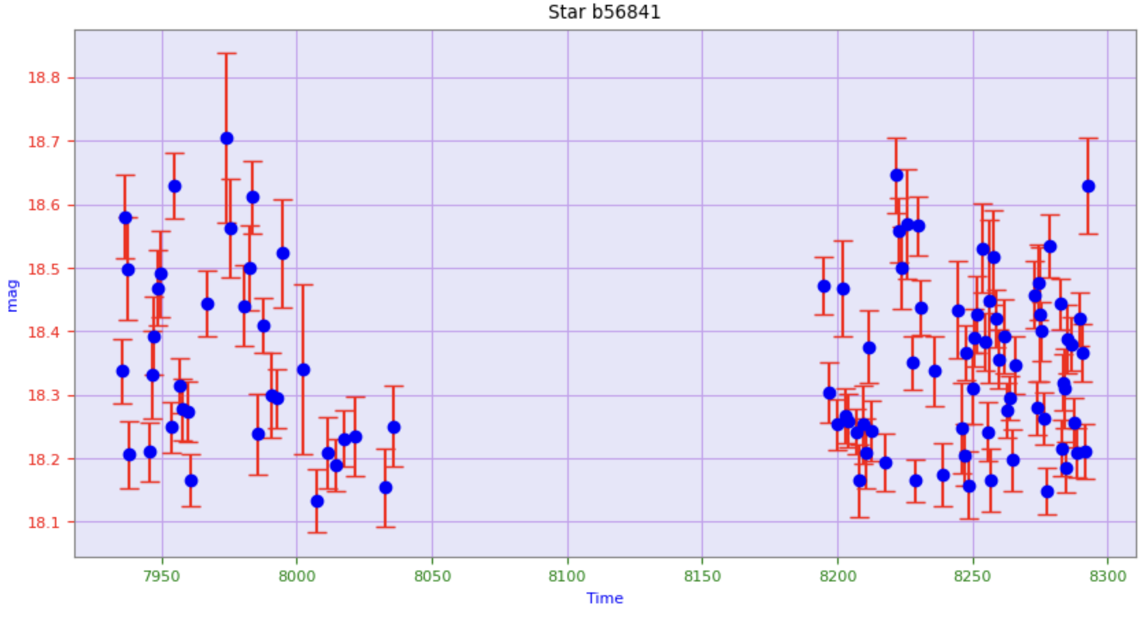
RRL Stars light curves:
when we gather multiple brightness measurements of a variable star and plot them against time, we create a graph known as a light curve.
Interruptions:
Ground-based telescopes.
Space telescopes.
Astronomers piece together the interrupted light curves like a puzzle and create Phase-folded light curves.

Slide 9
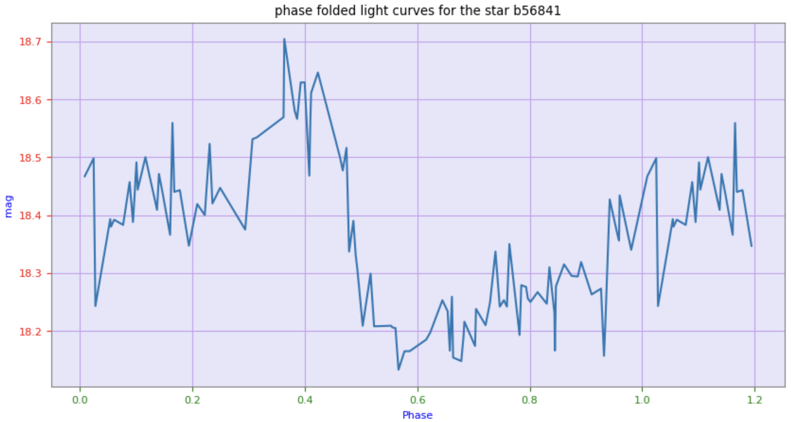
RRL Stars light curves:

Slide 10
RRL Stars classification:
Lyrae stars is RRab stars, also known as ”fundamental mode pulsators.” They are characterized by light curves with a rapid rise to maximum brightness, followed by a slower decline to minimum brightness. Another subclass of RR Lyrae stars is the RRc stars, referred to as ”first overtone pulsators.” In contrast to Rrab stars, RRc usually has a sinous-like shape. A less common subclass of RR Lyrae stars is RRd stars, known as ”double-mode pulsators.” These stars display a unique feature—double-mode pulsation—meaning they have two distinct periods of variability. Consequently, the light curve of RRd stars combines characteristics from both RRab and RRc stars.

Slide 11
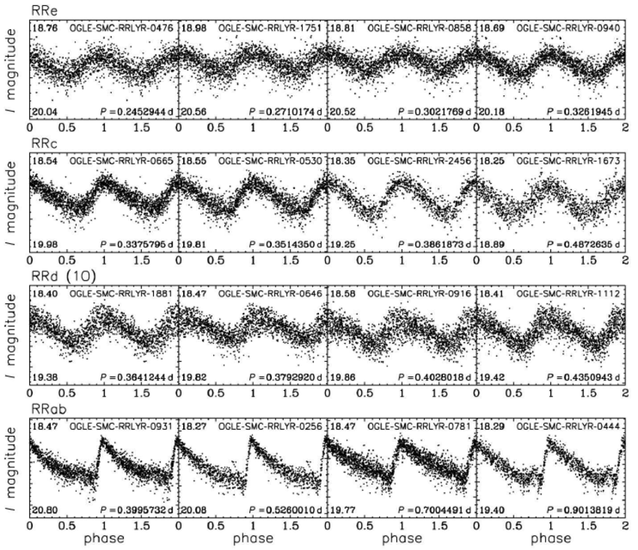
RRL Stars classification:

Slide 12
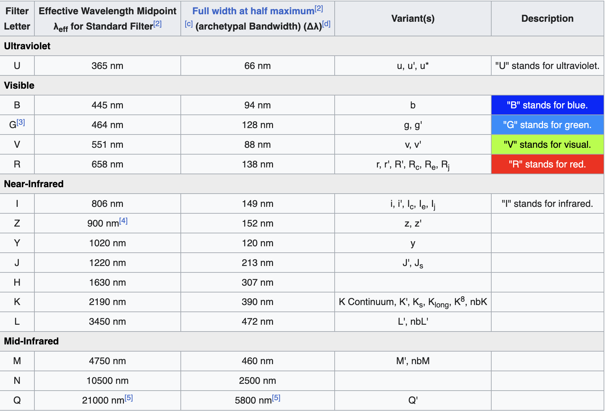
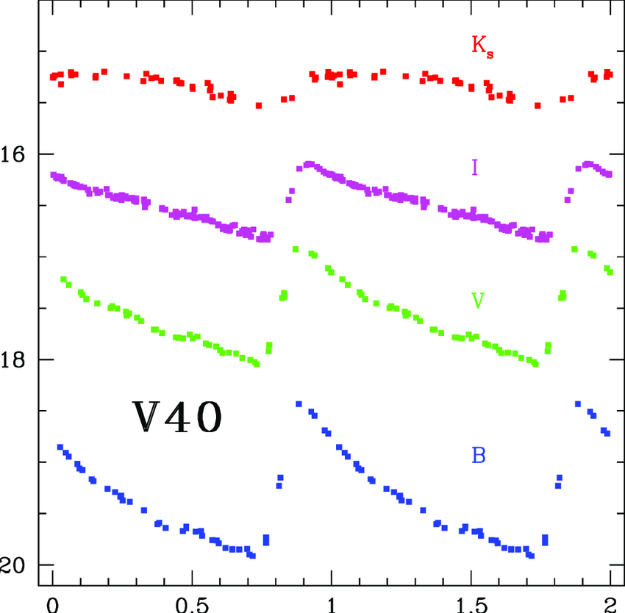
RRL Stars light curves in different bands:
RR Lyrae (RRL) stars exhibit variations in brightness across different wavelengths, which can be observed using different photometric bands.
RRL stars’ light curves are observed in some bands more because the observation in these bands are more common. (e.g. I band )
Catelan, Márcio & Minniti, Dante & Lucas, P. & Dekany, Istvan & Saito, R. & Angeloni, R. & Alonso-García, J. & Hempel, Maren & Hełminiak, K. & Jordán, A. & Ramos, R. & Navarrete, Camila & Beamin Muhlenbrock, Juan Carlos & Rojas, A. & Gran, Felipe & Lopes, C. & Peña, C. & Kerins, E. & Huckvale, L. & Chené, André-Nicolas. (2013). Stellar Variability in the VVV survey.

Slide 13
HDS Metallicity measurement:
The term "HDS" typically refers to High Dispersion Spectroscopy, which is a technique used in astronomy to obtain high-resolution and high-quality spectra of celestial objects, including RRL stars.
Spectral Lines: High dispersion spectroscopy allows astronomers to analyze the absorption lines in the star's spectrum. These lines are caused by specific elements in the star's atmosphere absorbing light at particular wavelengths.
Metal Lines: Elements heavier than hydrogen and helium, often referred to as "metals" in astronomy, produce distinct absorption lines in a star's spectrum. The strength and shape of these lines can provide information about the abundance of these elements, including metallicity.
Equivalent Width: Astronomers measure the equivalent width of absorption lines, which is a quantitative measure of the strength of the lines. The equivalent width can be compared to the equivalent widths of lines in stars of known metallicity to estimate the metal content of the target star.
Modelling and Calibration: High dispersion spectroscopy data can be compared to theoretical models of stellar atmospheres and spectral libraries containing spectra of stars with known metallicities. This comparison helps calibrate the metallicity estimation.

Slide 14
In some bands, we lack HDS data:
Observational Challenges:
A. Obtaining high-quality HDS data can be technically challenging and may require specialized equipment and significant telescope time.
B. Depending on the specific goals of an astronomical study, observations in certain wavelength bands may take precedence over others, leading to a bias in the available data.
2.Sensitivity of Instruments:
Not all spectrographs or instruments are optimized for observing in every wavelength band. Some instruments may have limitations or reduced sensitivity in certain spectral regions, making it difficult to obtain HDS data in those bands.

Slide 15
Problem:
How do we solve the problem of lack of data in certain photometric bands:
Gather light curves in a commonly observed photometric band. (in our case I) and calculate HDS metallicity measurement for them.
Gather light curves in another band that we lack HDS metallicity measurement, and calculate HDS metallicity measurement for them.
Model the relationship between the shape of light curves and the metallicity for the common band.
Transfer the model to the band we lack HDS measurement in the cost of a small systematic shift.

Slide 16
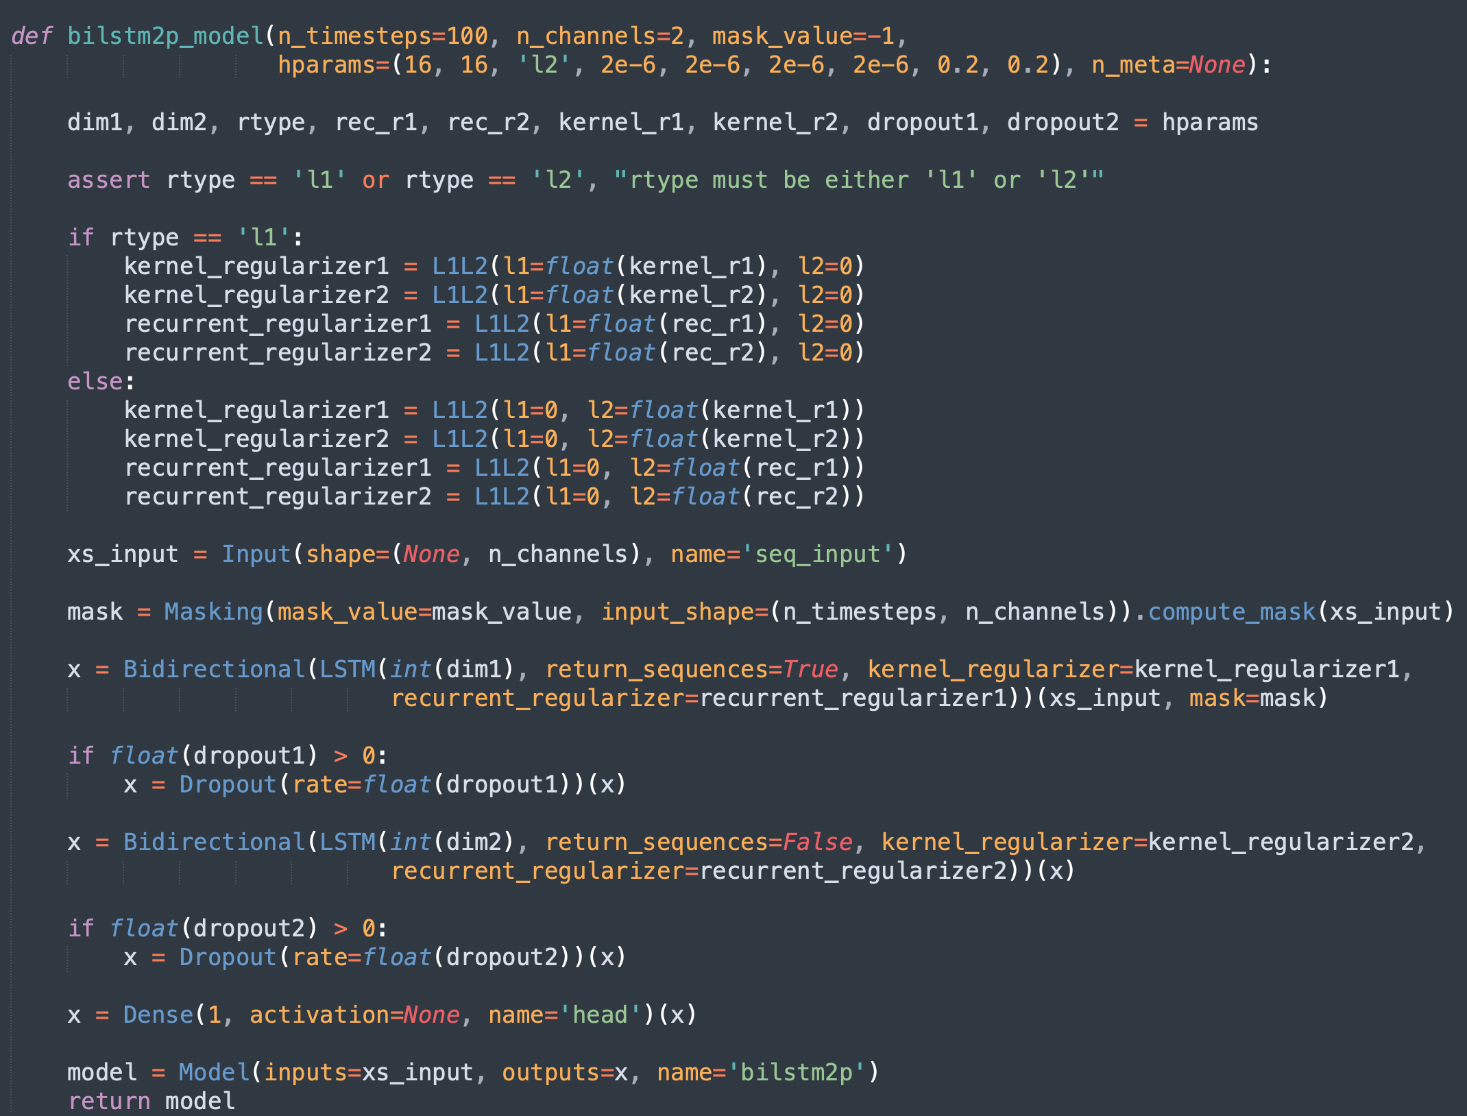
We used a deep-learning model for this purpose:
We modelled the deep learning method mentioned in the Dekany et al. 2021 paper:
The model is a RNN

Slide 17
Data assembly:
We took several steps:
Training:
A. Light curves (input):
We trained the model on DR2 (Gaia data release number 2) G band light curves beside the corresponding I band taken from the OGLE catalogue.
B. The metadata(features):
Calculated by Lcfit package package (Dékány 2022a).
C. Metallicity (Labels):
The Metallicities were calculated by lcfit package (Dékány 2022a).

Slide 18
Data assembly:
We took several steps:
Predicting and Transfer Learning:
A. Light curves (input):
We trained the model on DR3 (Gaia data release number 3)only G band light curves .
B. The metadata(features):
Calculated by Lcfit package package (Dékány 2022a).
C. Metallicity (Labels):
The Metallicities were calculated by Crestani el al (2021).

Slide 19
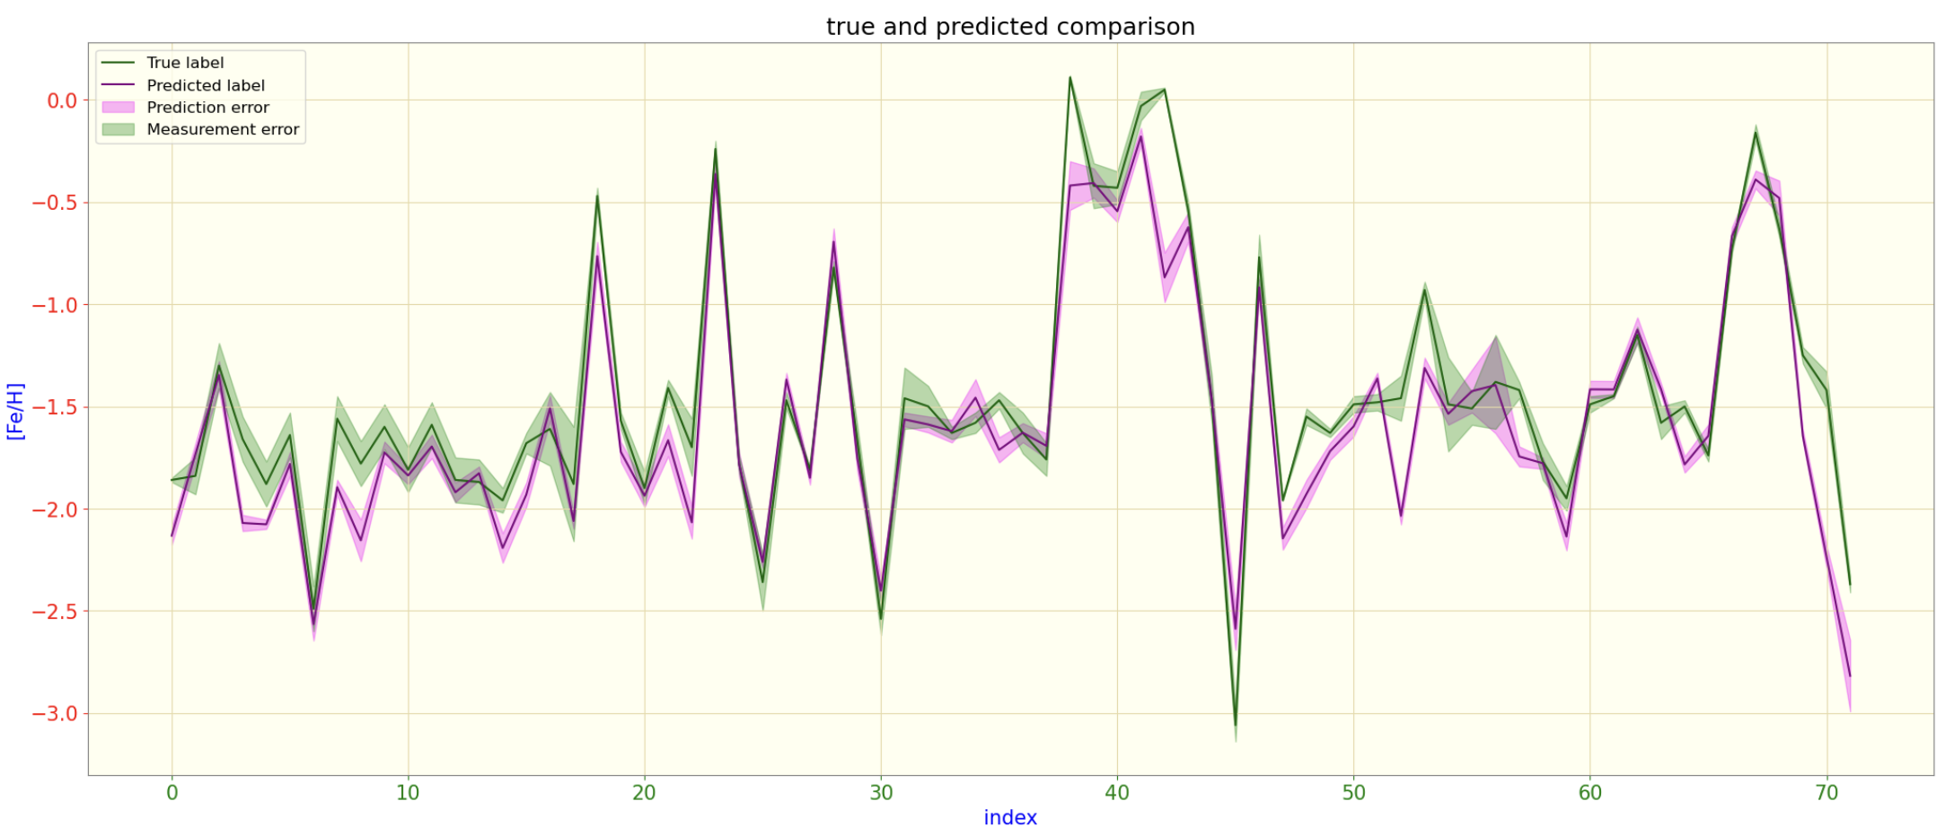
True and predicted comparison for Crestani’s G band light curves:

Slide 20
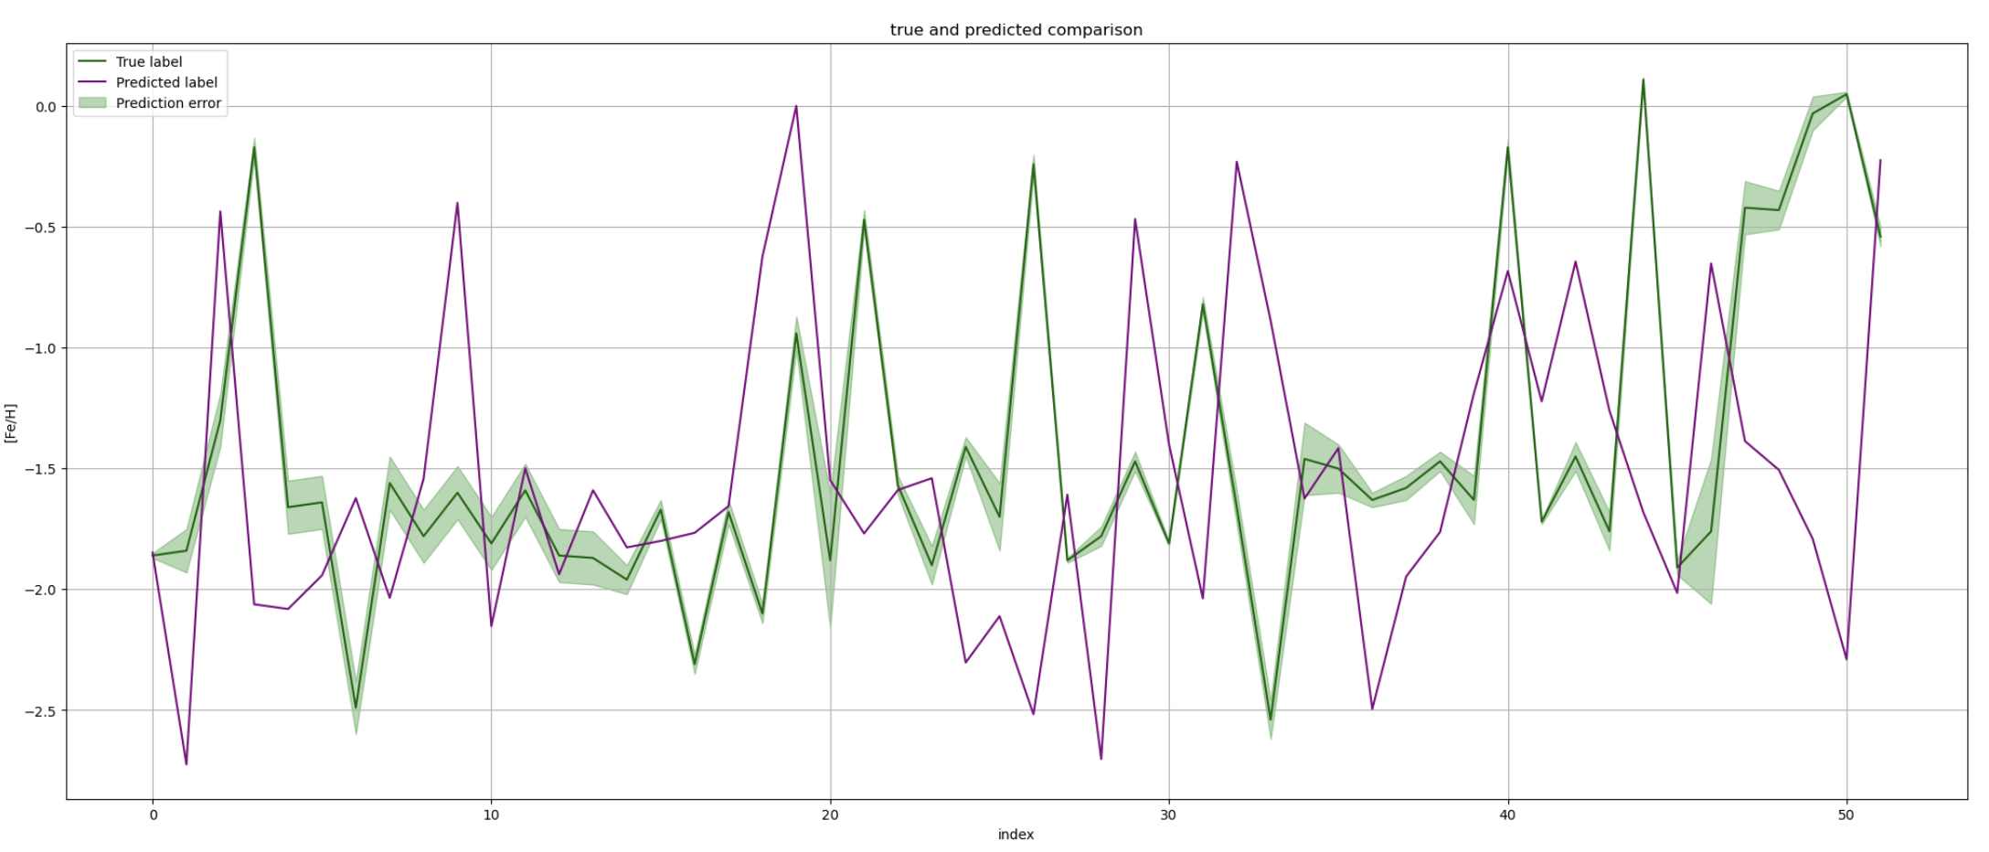
True and transfer learnt comparison for Crestani’s G band light curves:

Slide 21
Data assembly:
We took several steps:
Predicting :
A. Light curves (input):
We trained the model on only G band light curves calculated by Liu et al.
B. The metadata(features):
Calculated by Lcfit package package (Dékány 2022a).
C. Metallicity (Labels):
The Metallicities were calculated by calculated by Liu et al.

Slide 22
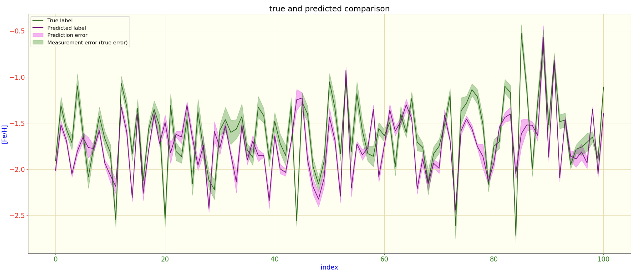
The true and predicted comparison for Liu’s data:

Slide 23
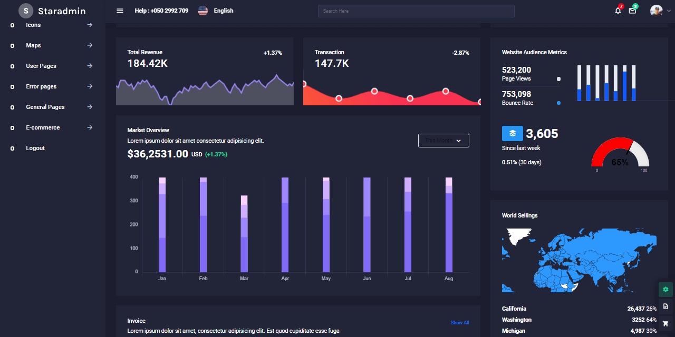
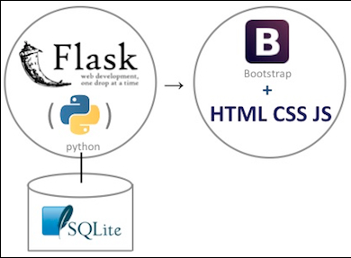
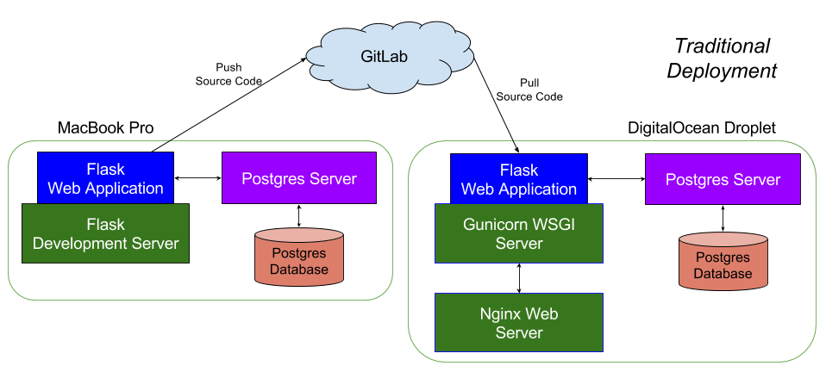
Creating a web app for this implementation for users:

Slide 24
Thanks for your time

